Slide 1

COMMUNICATION USING LASER
A Brief Overview

Slide 2
COMMUNICATION USING LASER
Any Microcontroller
Solar Panel as Receiver
IC 7414 – D Trigger Flip-flop
2N2222 Transistor (Pre-Amplifier)
Op – Amp TL072 (Dual I/O)
D882 Transistor (Power Amplifier)
2X LASER Beam for Tx & Rx
Logic Level Convertor (3.3V & 5V)
TRANSMITTER SECTION
RECEIVER SECTION

Slide 3
COMMUNICATION USING LASER
We are thinking of implementing this design as a High-Bandwidth & Long Distance Reliable Mode of
Analog-Digital Conversion using pulsating LASER Beams. The transmitter will include an Arduino & the receiver can be another microcontroller like Arduino, NodeMCU or Raspberry Pi. We can transmit sensor data / preset data / user custom data and maybe multimedia content over long distances at extremely-high power efficiency & ultra-low cost margins to generate a complete IOT Network without cabling or a dedicated Networking system like WIFI.
We initially thought of using an LDR in the Receiver section but the LDR is usually biased by the power supply & usually slow to react to changing intensity of light patters so we required a more reliable approach. Solar panel was the best candidate, since it was extremely accurate & it generates voltage on its own when excited by charged photons. We just amplified that little current it generated just from a simple laser beam (we used a Focussed Torch since we have damaged our Laser Beam) using 2 High Gain and 2 Power Transistors to create a fast-accurate signal. With little calibration with capacitors, shunt resistances and signal diodes, we could isolate noise from the circuit as well.

Slide 4
Tinkercad to reality
Some Shots of the Alpha Build

Slide 5
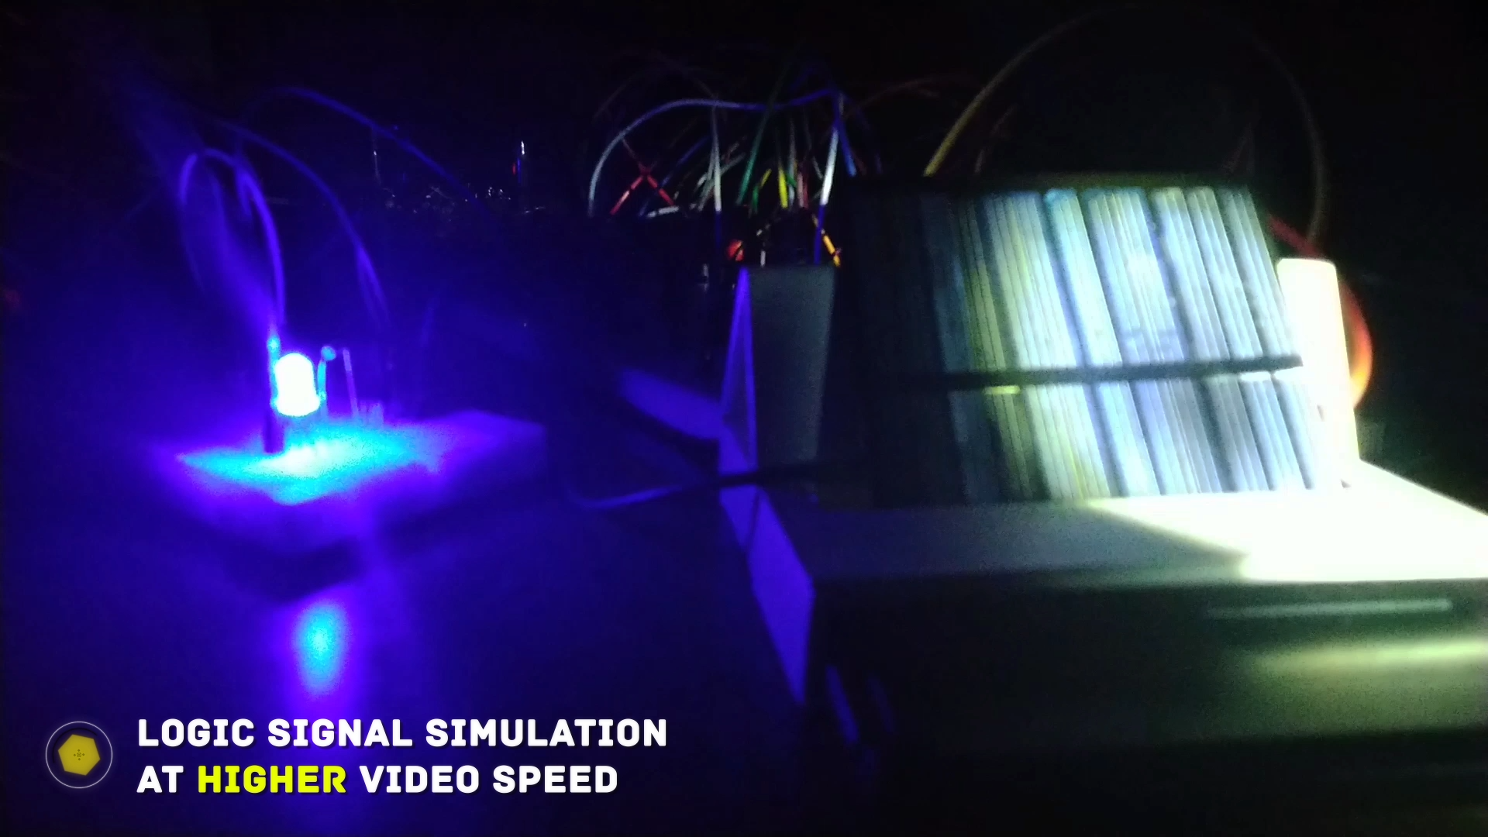
COMMUNICATION USING LASER

Slide 6
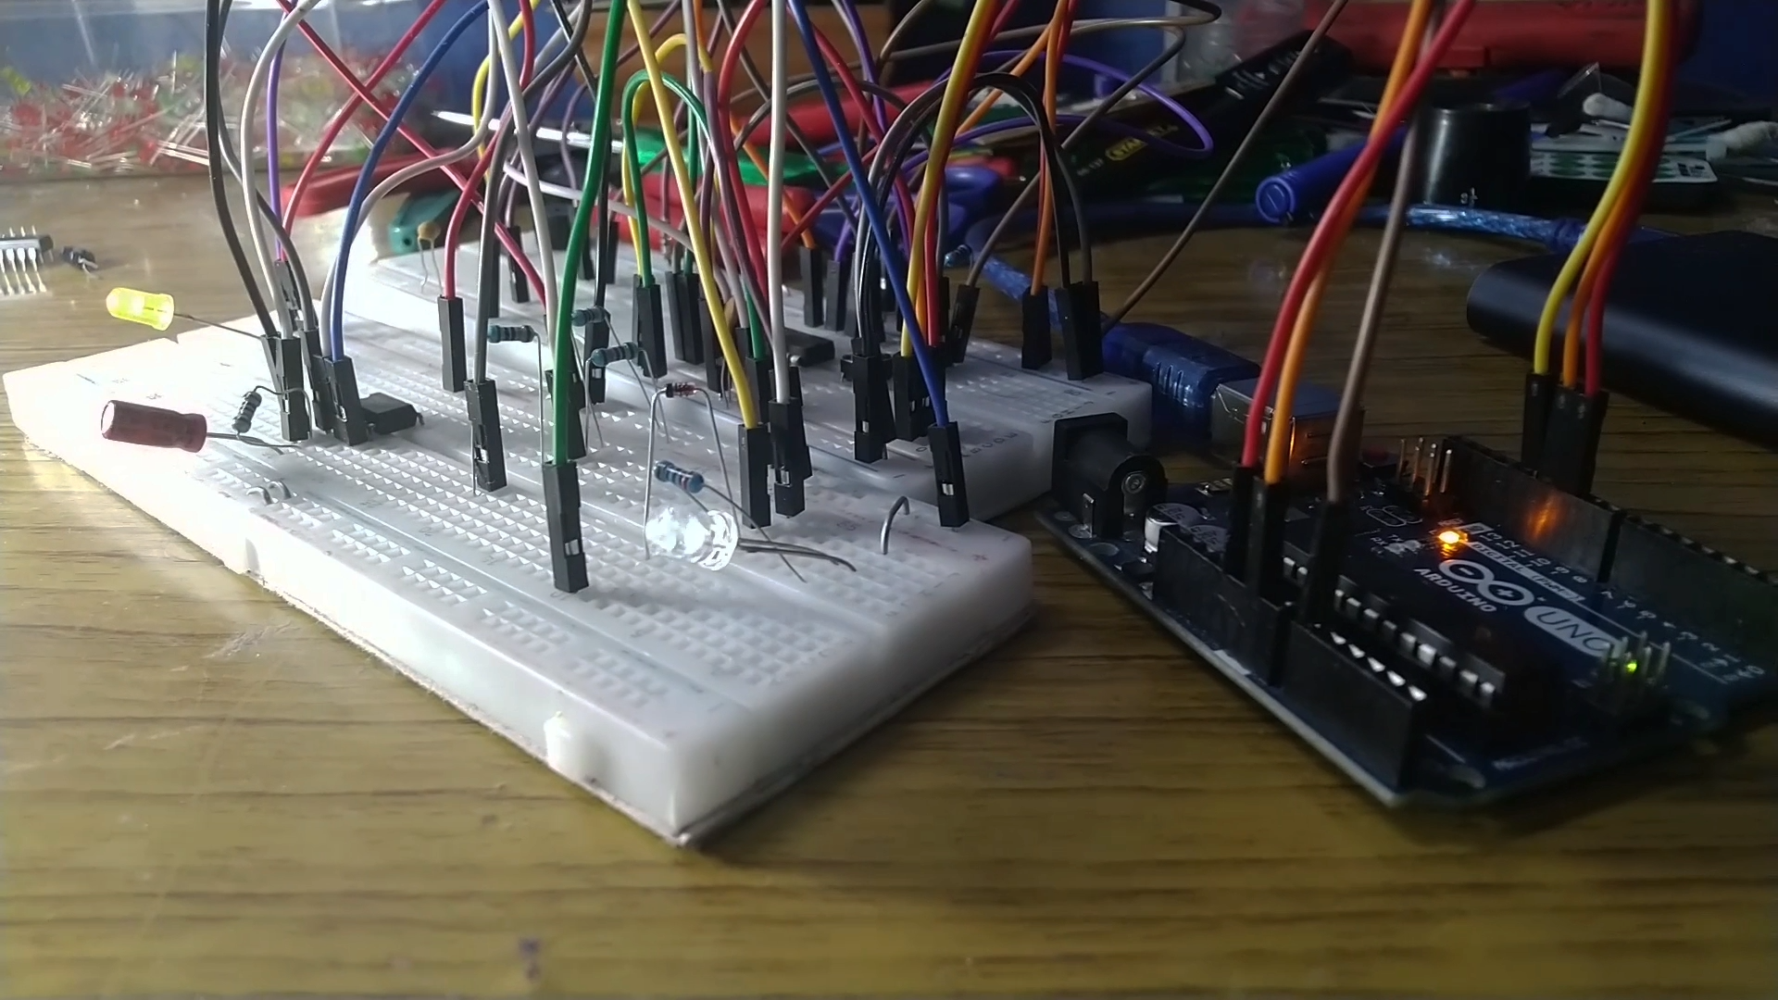

Slide 7
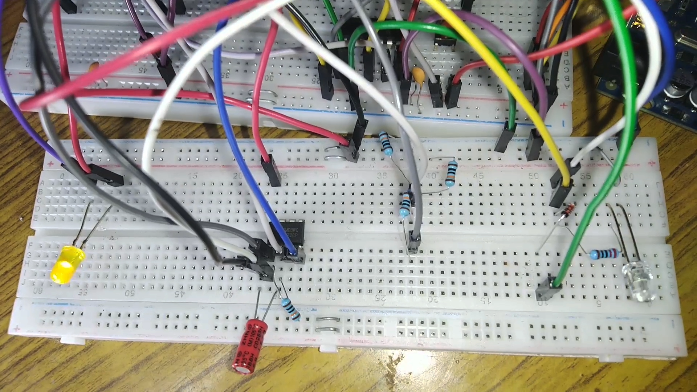

Slide 8
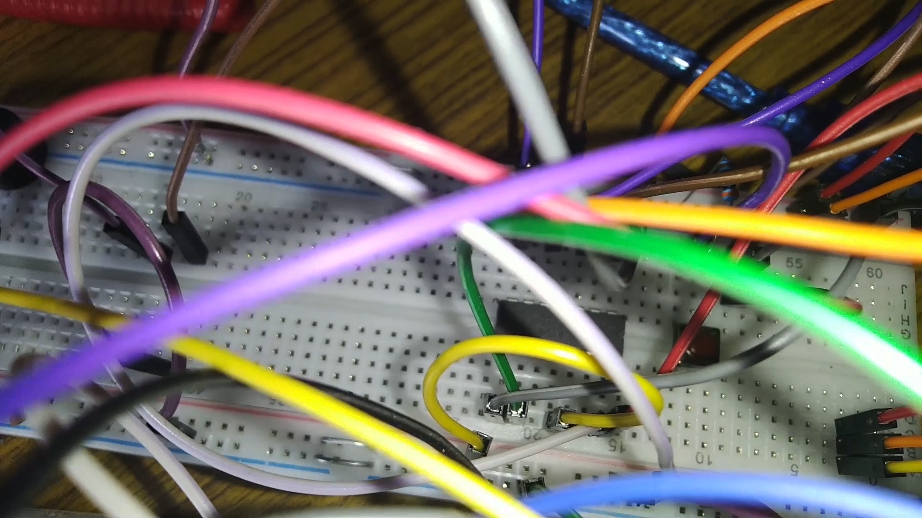

Slide 9
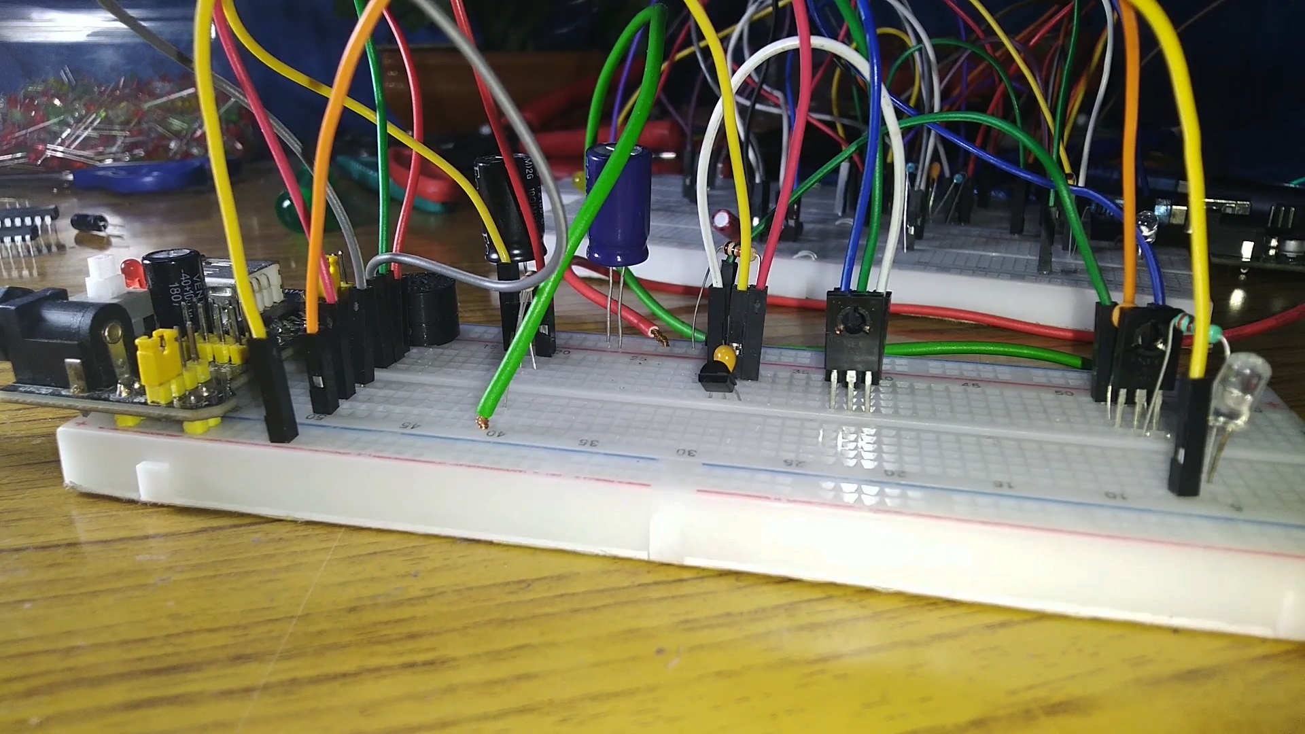

Slide 10
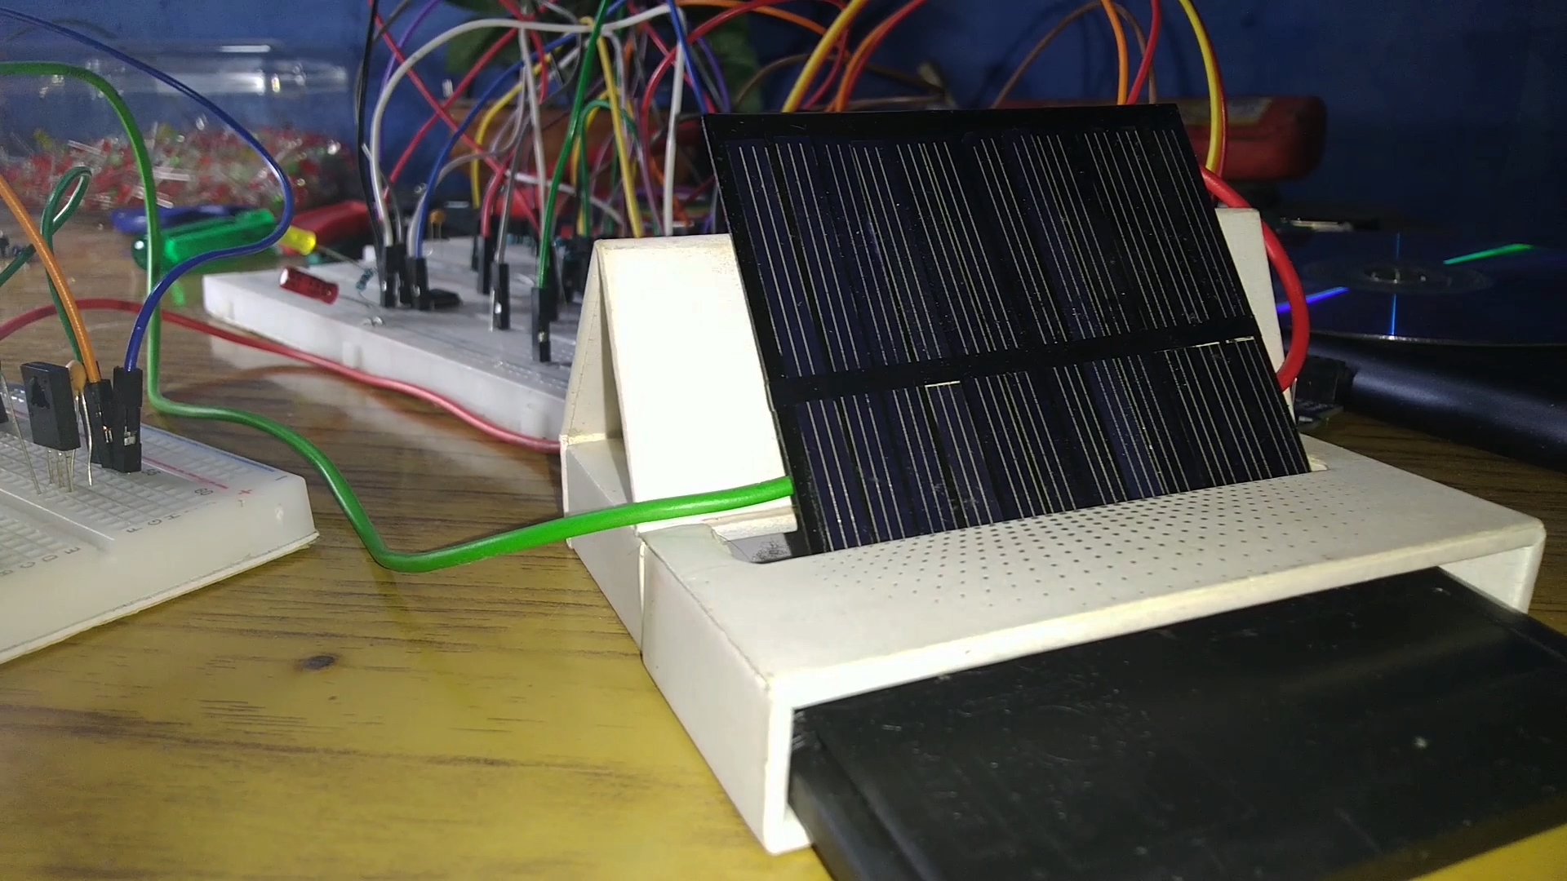

Slide 11
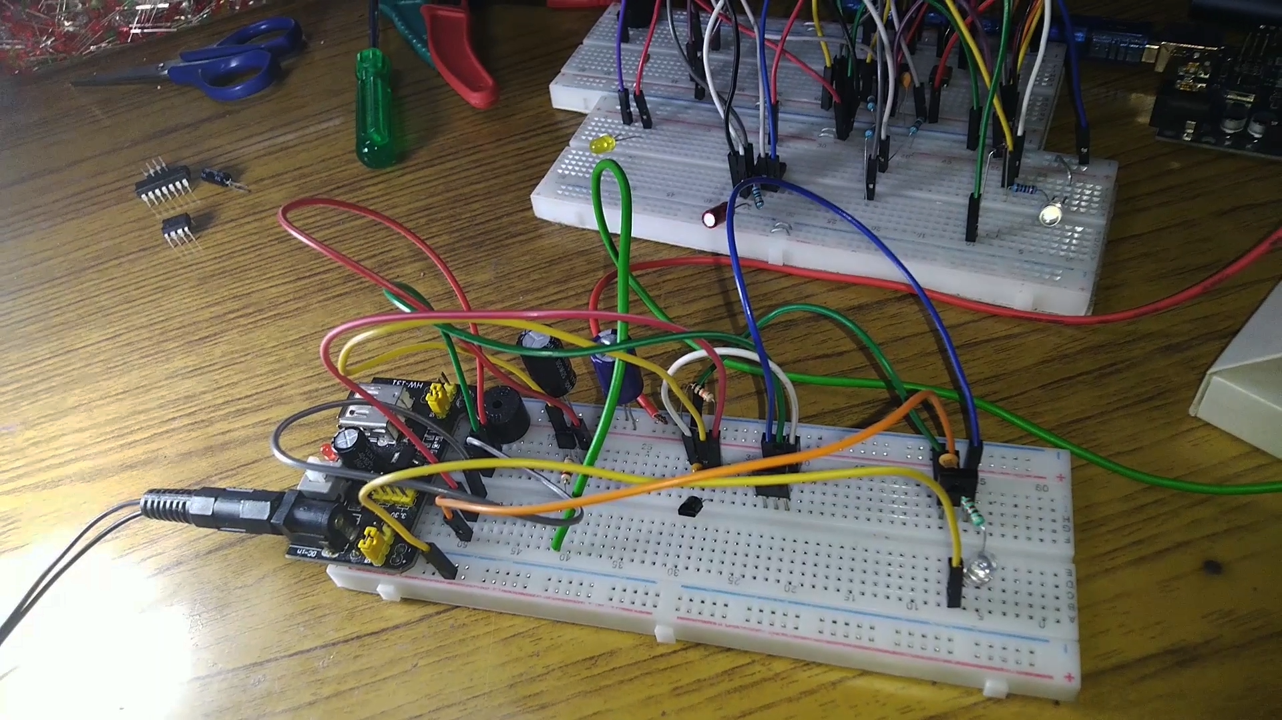

Slide 12
THANK YOU
Section : C
CSE (C6)
Mananjay Roy Tandrita Dey
Kajal Singha Deepprabha Malviya Baishakhi Dutta Tuhinadri Banerjee

